Slide 1
Cloud Ecosystems
Session 02
Course : COSC6100001 - Cloud Infrastructure
D6825 - Samuel Philip

Slide 2
Learning Objectives
At the end of this session, the student will be expected to :
Students able to explain delivery model and services of cloud computing
Students known and able to explain the challenges of Cloud Computing
Students known and able to describe the provider of cloud computing and it’s services

Slide 3
Outline
Cloud Computing Delivery Models and Services
Challenges Faced by Cloud Computing
Cloud Computing as a Disruptive Technology
Cloud Service Provider

Slide 4
Cloud Computing Delivery Models and Services

Slide 5
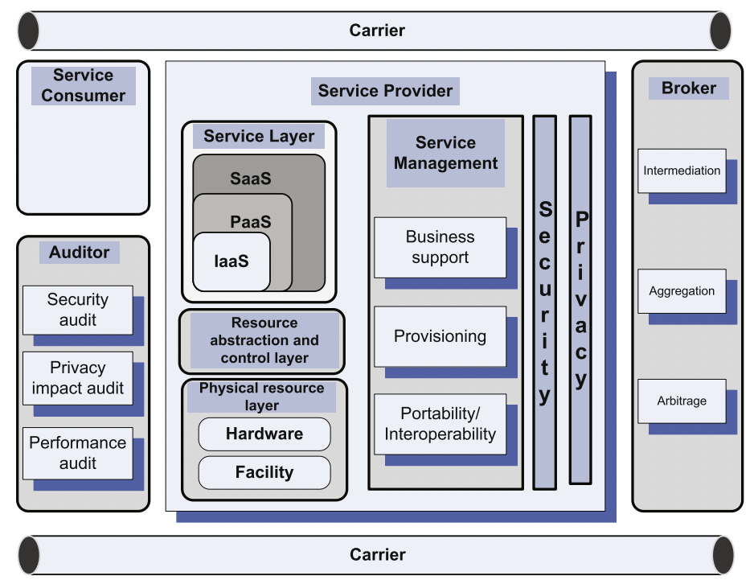
Entities Involved in Cloud Computing
These entities will work together
Service consumer: maintains a business relationship with, and uses service from, service providers
Service provider: responsible for making a service available to service consumers
Carrier: Intermediary providing connectivity and transport of cloud services between providers and consumers
Broker: Manage the use, performance, and delivery of cloud services, and negotiates relationships between providers and consumers
Auditor: A party that can conduct independent assessment of cloud services, information system operations, performance and security of the cloud implementation

Slide 6
Cloud Delivery Models
Cloud Service Providers (CSPs) support one or more cloud delivery models:
SaaS (Software as a Service)
PaaS (Platform as a Service)
IaaS (Infrastructure as a Service)
DBaaS (Database as a Service)
Notes:
SaaS is a centrally hosted service based on a subscription model for licensed software
PaaS provide a computing platform and applications, without the need to manage the infrastructure required to build and run the applications
IaaS is the model where the CSP provides a menu resource bundles and the users can choose the operating system and manage the resources in the bundle
DBaaS enables users to setup and operate several databases using a common set of abstractions, without the need to know the exact implementations of the abstractions for individual databases

Slide 7

SAAS (software as a service)
A wide range of stationary and mobile devices enable a large population of clients to access services provided by the applications using a thin client interface such as a web browser.
The users of services do not manage manage or control the underlying cloud infrastructure including network, servers, operating systems, storage, or even individual application capabilities, with the possible exception of limited user-specific application configuration setting.
The SaaS delivery model is not suitable for applications requiring real-time response or those in which data is not allowed to be hosted externally.

Slide 8

SAAS (software as a service)
example
SaaS is the most popular for it’s ease of use
Enterprise service such as workflow management
Group-ware and collaborative
Supply chain
Communications
Digital signature
Customer relationship management (CR)
Desktop software
Financial management
Geo-spatial
Search.

Slide 9
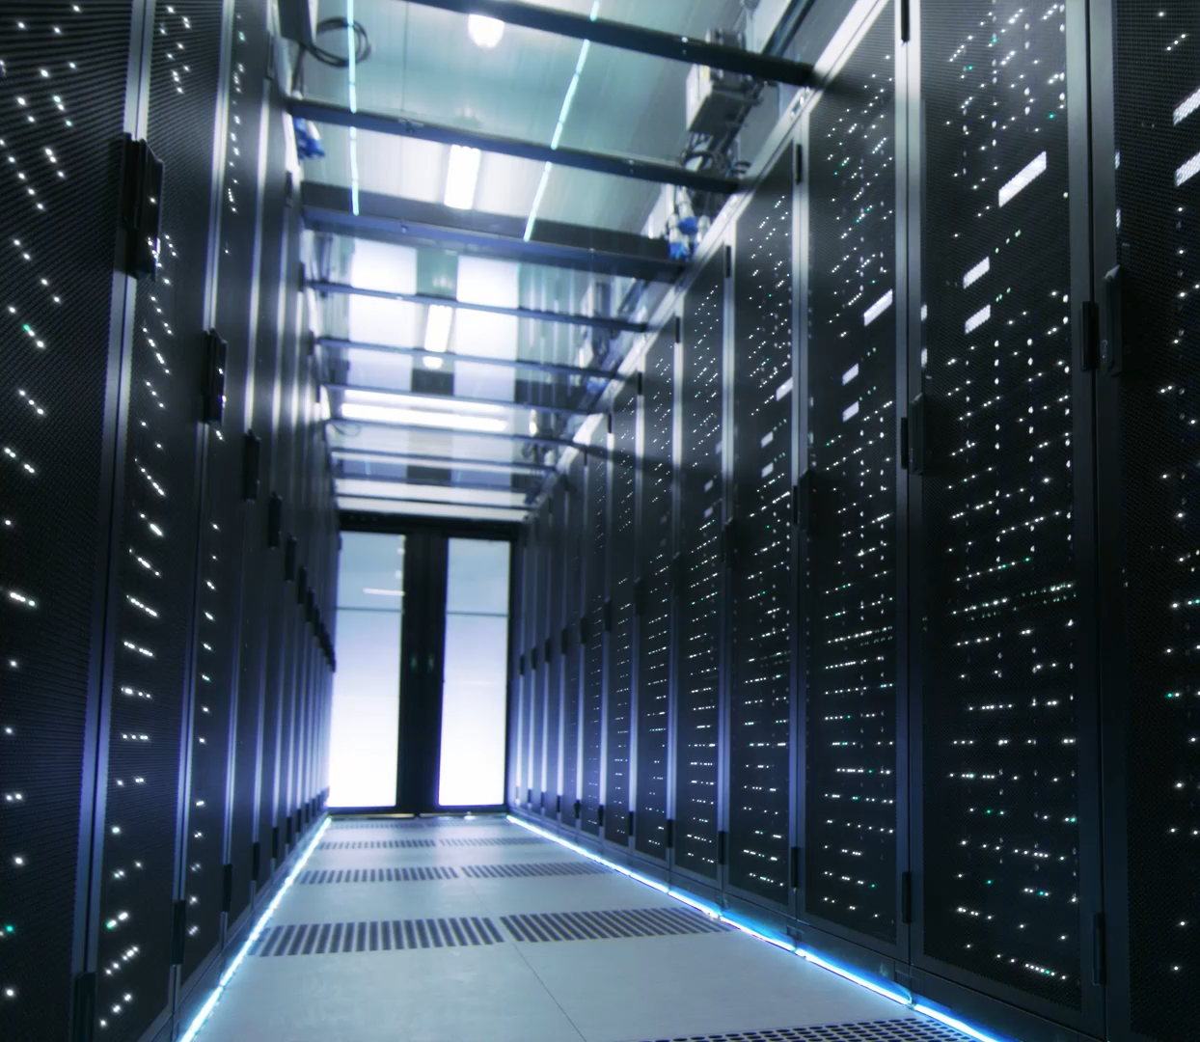
PAAS (platform as a service)
PaaS offers the capability to deploy consumer-created or acquired applications using programming languages and tools supported by the provider.
The user does not manage or control the underlying cloud infrastructure including the network, servers, operating systems, or storage.
The user has control over the deployed applications and, possibly, applications hosting environment configurations.
PaaS is not particularly useful when the application must be portable, when proprietary programming languages are used, or when the underlaying hardware and software must be customized to improve the performance of the application

Slide 10
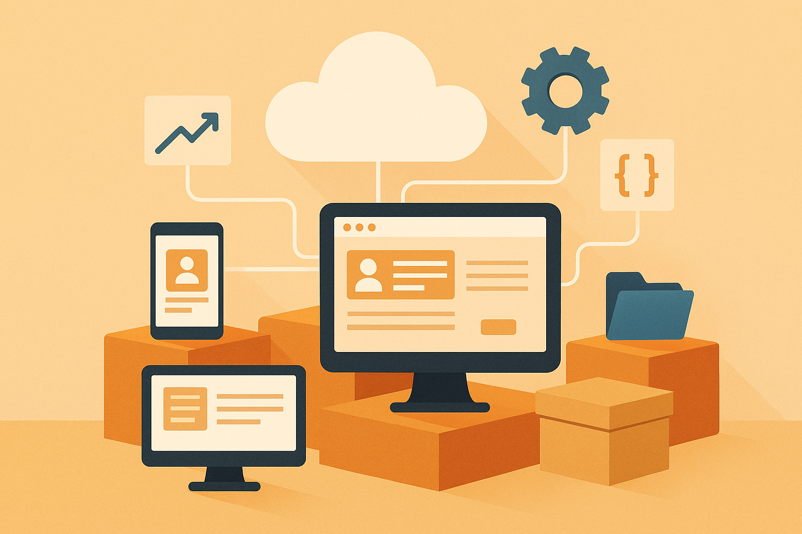
PaaS Example
Session management
Device integration
Sandboxes
Instrumentation and testing
Contents management
Knowledge management
Universal Description, Discovery, and Integration (UDDI)
A platform-independent
Extensible Markup Language (XML)-based registry providing a mechanism to register and locate web-service applications.

Slide 11
IaaS (Infrastructure as a Service)
IaaS has the capability to provide processing, storage, networks, and other fundamental computing resources.
The consumer is able to deploy and run arbitrary software, which can include operating systems and applications.
The consumer does not manage or control the underlying cloud infrastructure but has control over operating systems, storage, deployed applications, and possibly limited control of some networking components.

Slide 12

IaaS Example
Server hosting
Web servers
Storage
Computing hardware
Operating systems
Virtual instances
Load balancing
Internet access
Bandwidth provisioning.

Slide 13
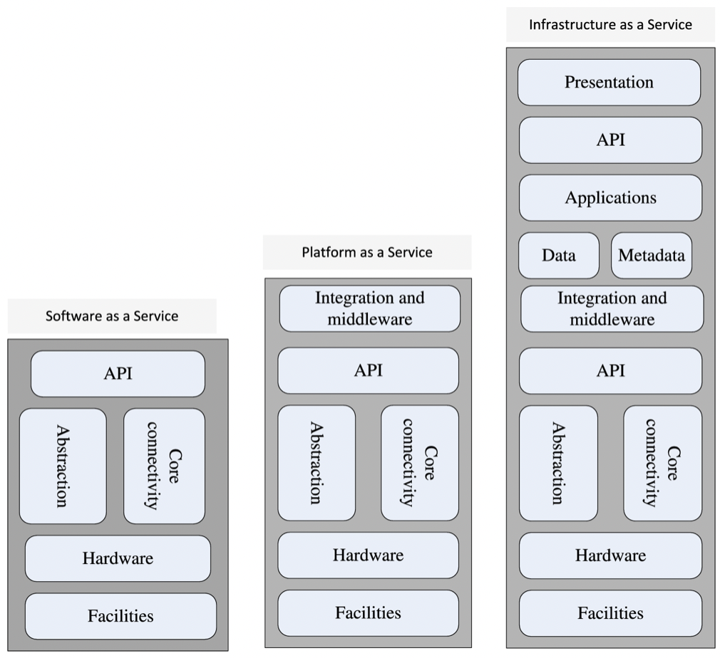
Software and Cloud Infrastructure
Software and cloud infrastructure control versus ease of use of the service.
SaaS allows no infrastructure control and does not require any sophistication to use applications supplied by CSP.
PaaS supports consumer-created or acquired applications using CSP-provided tools.
IaaS empowers advanced developers and uses to choose the operating system, run arbitrary software, choose the type of instances, and manage instance resources
Notes:
Software and cloud infrastructure control versus ease of use of the service.
SaaS allows no infrastructure control and does not require any sophistication to use applications supplied by CSP.
PaaS supports consumer-created or acquired applications using CSP-provided tools.
IaaS empowers advanced developers and uses to choose the operating system, run arbitrary software, choose the type of instances, and manage instance resources

Slide 14
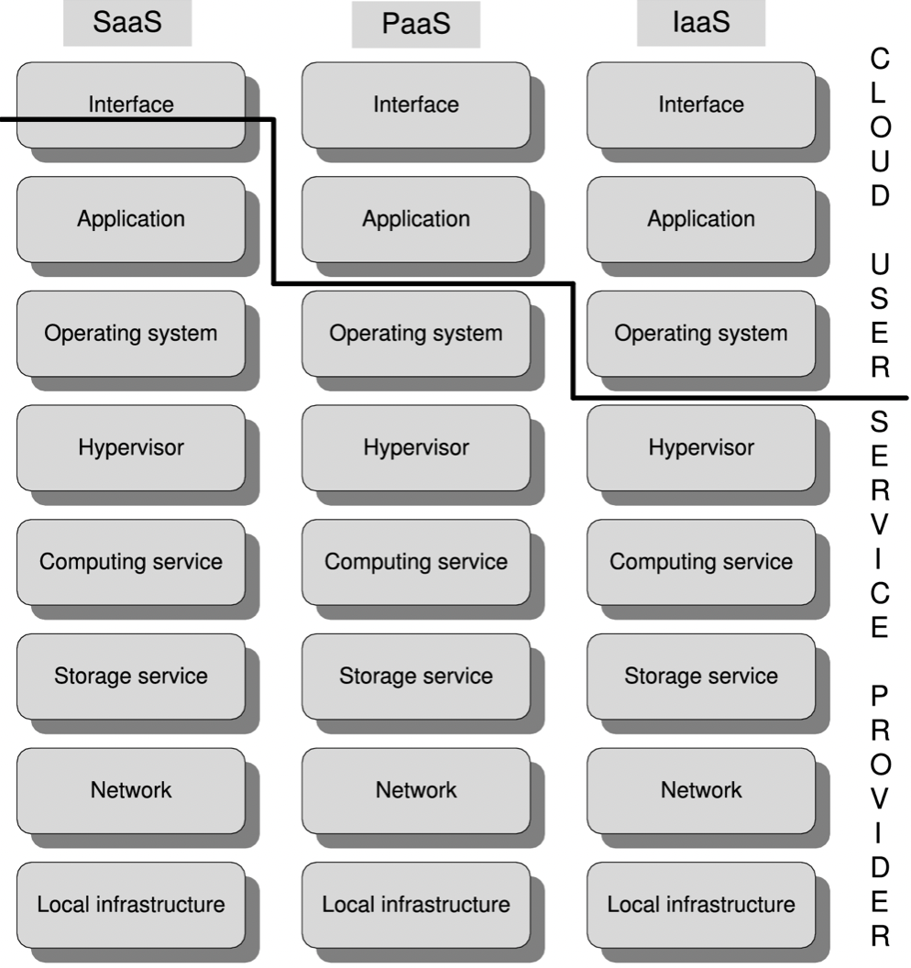
The Limits of Responsibility Between a Cloud User and The Cloud Service Provider

Slide 15

DBaaS (Database as a Service)
DBaaS is a cloud service where the database runs on the service provider physical infrastructure.
Cloud database service advantages :
- Instantaneous Scalability
- Performance Guarantees
- Specialized Expertise
- Latest Technology
- Failover support
- Declining Pricing

Slide 16
DBAAS features
Self-service – service provisioning without major deployment or configuration and without performance and cost penalties.
Device and location-independent abstract database resources without concern for hardware utilization
Elasticity and scalability – automated and dynamic scaling
Pay-as-you-go model – metered use of resources and cost reflecting the resources used
Agility – the applications adapt seamlessly to new technology or additional requirements.

Slide 17
IaC (Infrastructure as Code)
The precisely function of IaC is to takes advantage of virtualization and cloud native development allowing developers to provision their own virtual servers or containers on demand
Such as: manage servers, operating systems, database connections, storage, and other infrastructure elements using a high-level descriptive language.

Slide 18
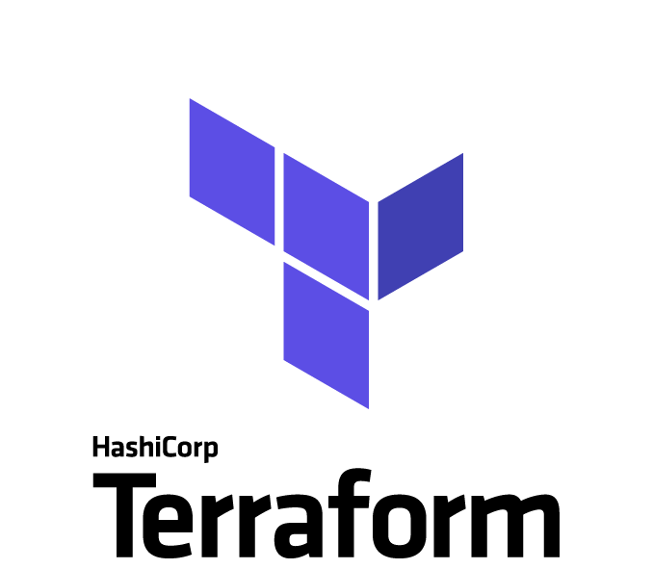
IaC Tools
The most used IaC tools are Ansible and Terraform.
Ansible : is an open-source IT automation engine that is used improve the scalability, consistency, and reliability of the IT environment
Terraform : automates resource management across multiple providers, regardless of where physical servers, DNS servers, or databases reside and provisions applications written in any languages.

Slide 19
Challenges Faced by Cloud Computing

Slide 20



Cloud computing major challenge
Interoperability and Standardization - Vendor lock-in, the fact that a user is tied to a particular cloud service provider is a major concern for cloud users.
Security - The most significant challenge, gaining the trust of a large user base is critical for the future of cloud comp
Cloud Resource Management - A systematic, rather than ad hoc, resource-management strategy requires the existence of controllers tasked to implement several classes of policies
Notes:
Security : The most significant challenge, gaining the trust of a large user base is critical for the future of cloud computing. It is unrealistic to expect that a public cloud will provide a suitable environment for all applications. Several issues are like to protect private information such as financial or healthcare services, defend against attack such as denial-of-service (DoS) attacks, and the most vulnerable to attacks is the data in storage.
Cloud Resource Management : A systematic, rather than ad hoc, resource-management strategy requires the existence of controllers tasked to implement several classes of policies; admission control, capacity allocation, load balancing, energy optimization, and to provide Quality of Service (QoS) guarantees.
Interoperability and Standardization : Vendor lock-in, the fact that a user is tied to a particular cloud service provider is a major concern for cloud users. Standardization would support interoperability and, thus, alleviate some of the fears that a service critical for a large organization may not be available for an extended period of time. But imposing standards at a time when a technology is still evolving is not only challenging but can be counterproductive because it may stiffen innovation.

Slide 21

Cloud Computing as a Disruptive Technology
Computer clouds are changing the enterprise computing landscape at a stunning speed. The top reason why companies migrate to the cloud is cost-cutting.
Company revenues prediction when applied cloud services:
- PaaS Model : from $26.4 to $58.0 billion
- SaaS Model : from $85.7 to $151.1 billion
- IaaS Model : from $32.4 to $74.1 billion
A 2021 study reports that : 78% of organizations participating in the study use hybrid clouds, i.e., public and private; 19% use only public and 2% use one private clouds; and 31% of respondents spend more than $12 million annually on cloud computing
AWS has the largest cloud computing market share of 32%. Dropbox, Google Drive, and Microsoft OneDrive are the leading cloud storage providers with 47.3%, 26.9%, and 15.3% of the market, respectively.

Slide 22
Exercise
Find article related to implementation of Cloud Computing Technology
Find cases related to QoS problem of Cloud services

Slide 23
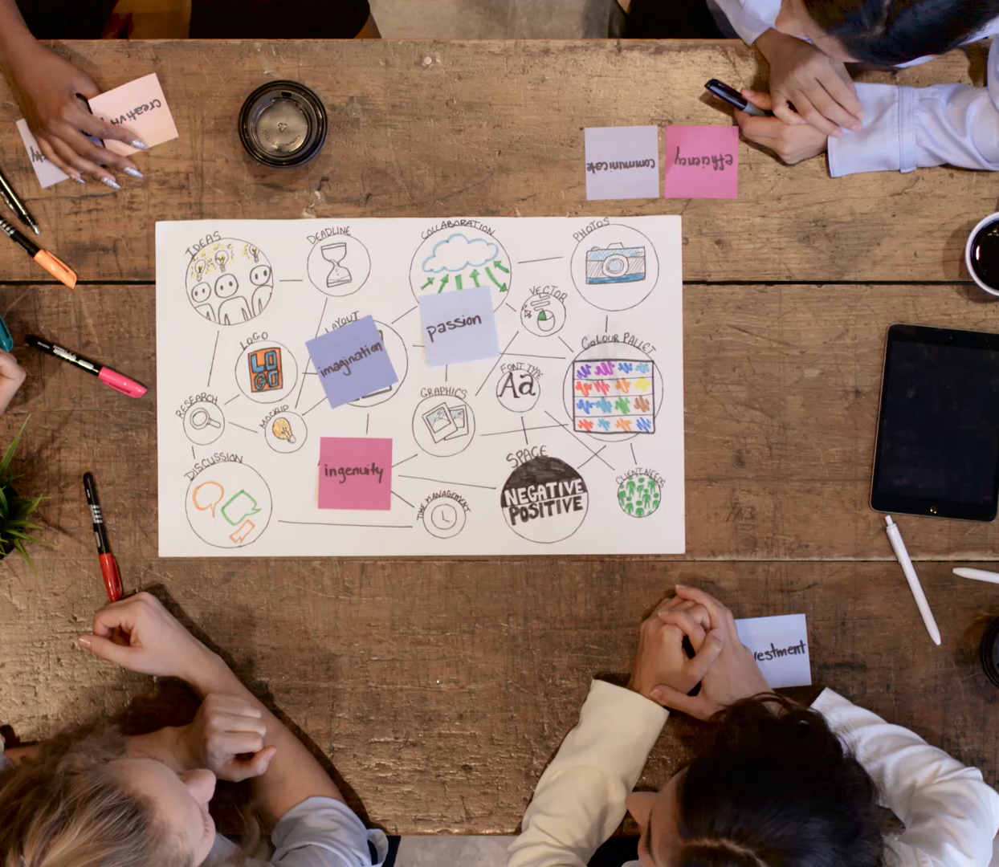
Assignment
Students in the class make 4 Groups
Each group pick one of cloud service provider
In 30 minutes (estimate), each group present their discuss about cloud service provider (estimate each group have 5-10 minutes to presentation)
(Minimal content must included in discussion : Cloud type, delivery model, services, applications)?

Slide 24
References
Marinescu, Dan C. (2022). Cloud Computing Theory and Practice: 3rd Edition. Morgan Kaufmann Publishers. ISBN: 978-0-323-85277-7
https://www.ucsusa.org/resources/each-countrys-share-co2-emissions

Slide 25
Thankyou

